Slide 1



Lord Sandwich’s Legacy

Slide 2


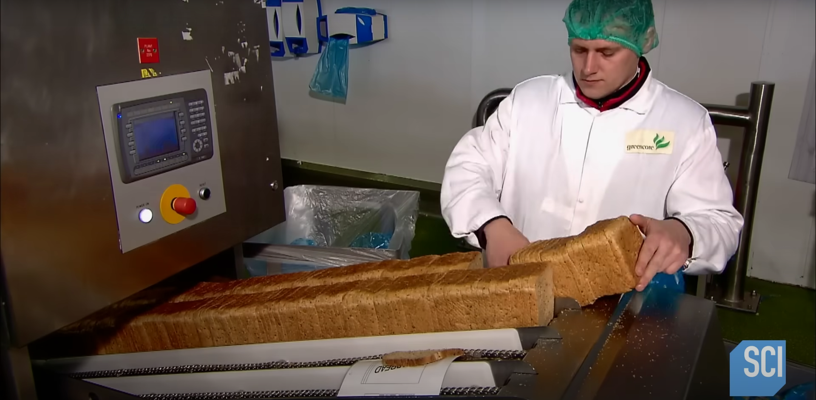
Step 1
Fresh bread is being loaded to an automated machine. It is being done manually to inspect and pick quality bread.

Slide 3
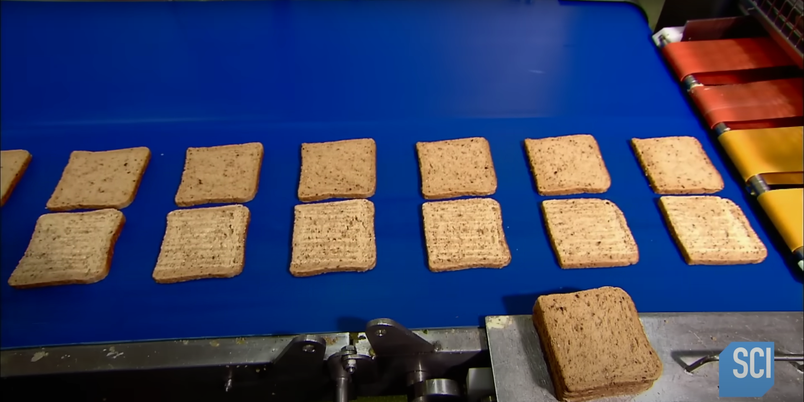
Step 2
Slices are being separated from one another.

Slide 4
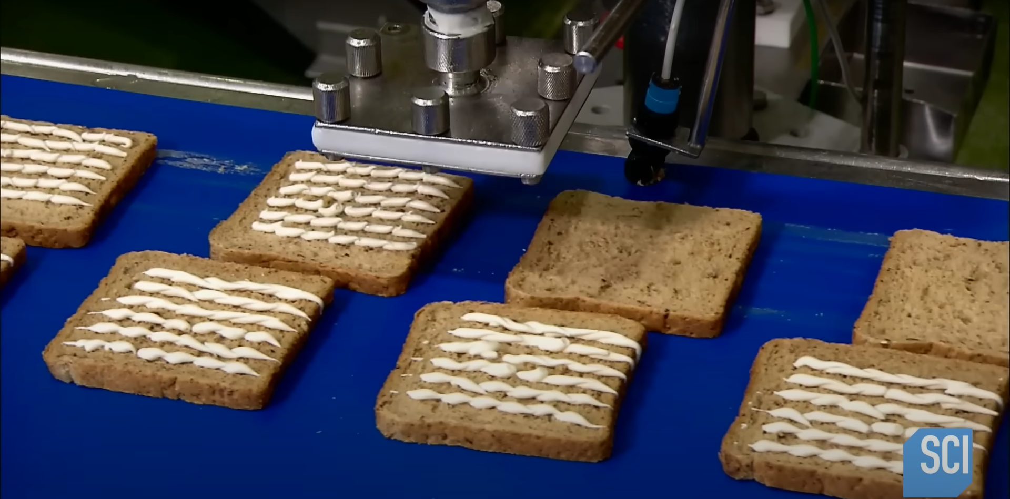
Step 3
Butter is being put to the slices.

Slide 5
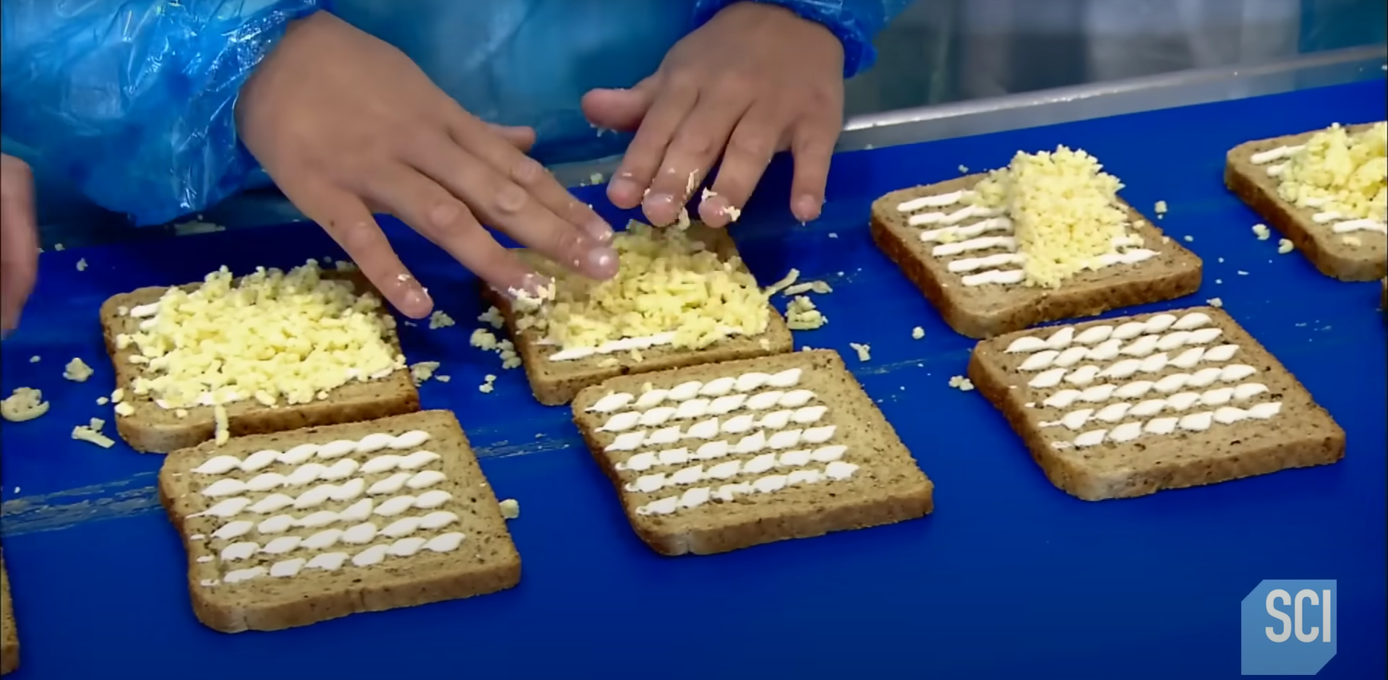
Step 4
Cheder is being placed manually.

Slide 6
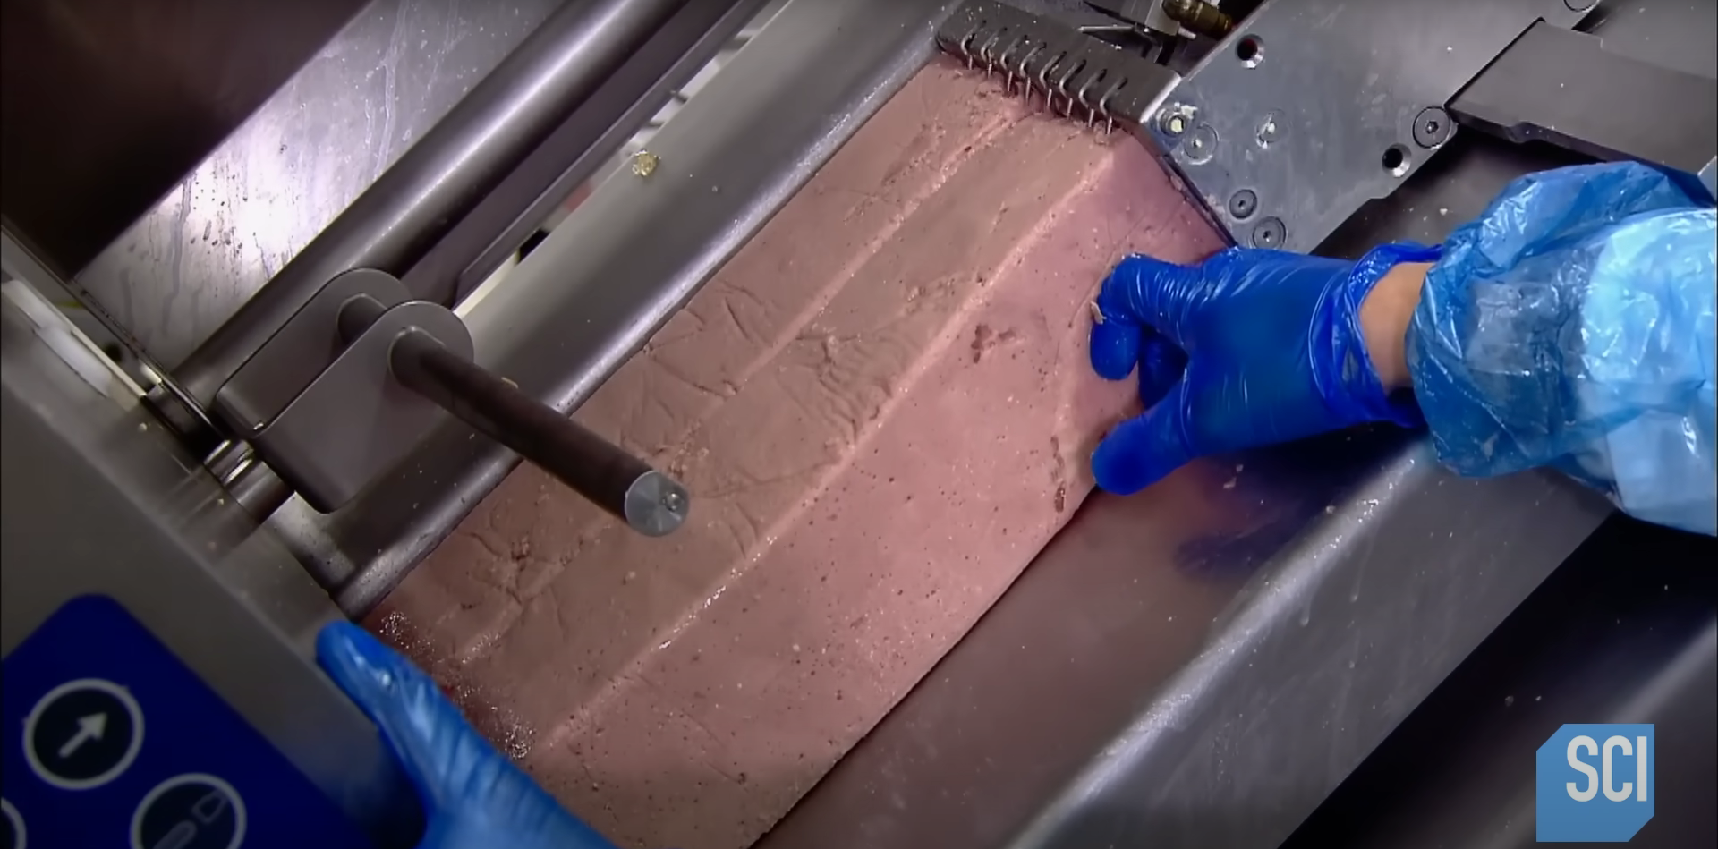
Step 5
Ham is being put to slicing and picked by a worker.

Slide 7
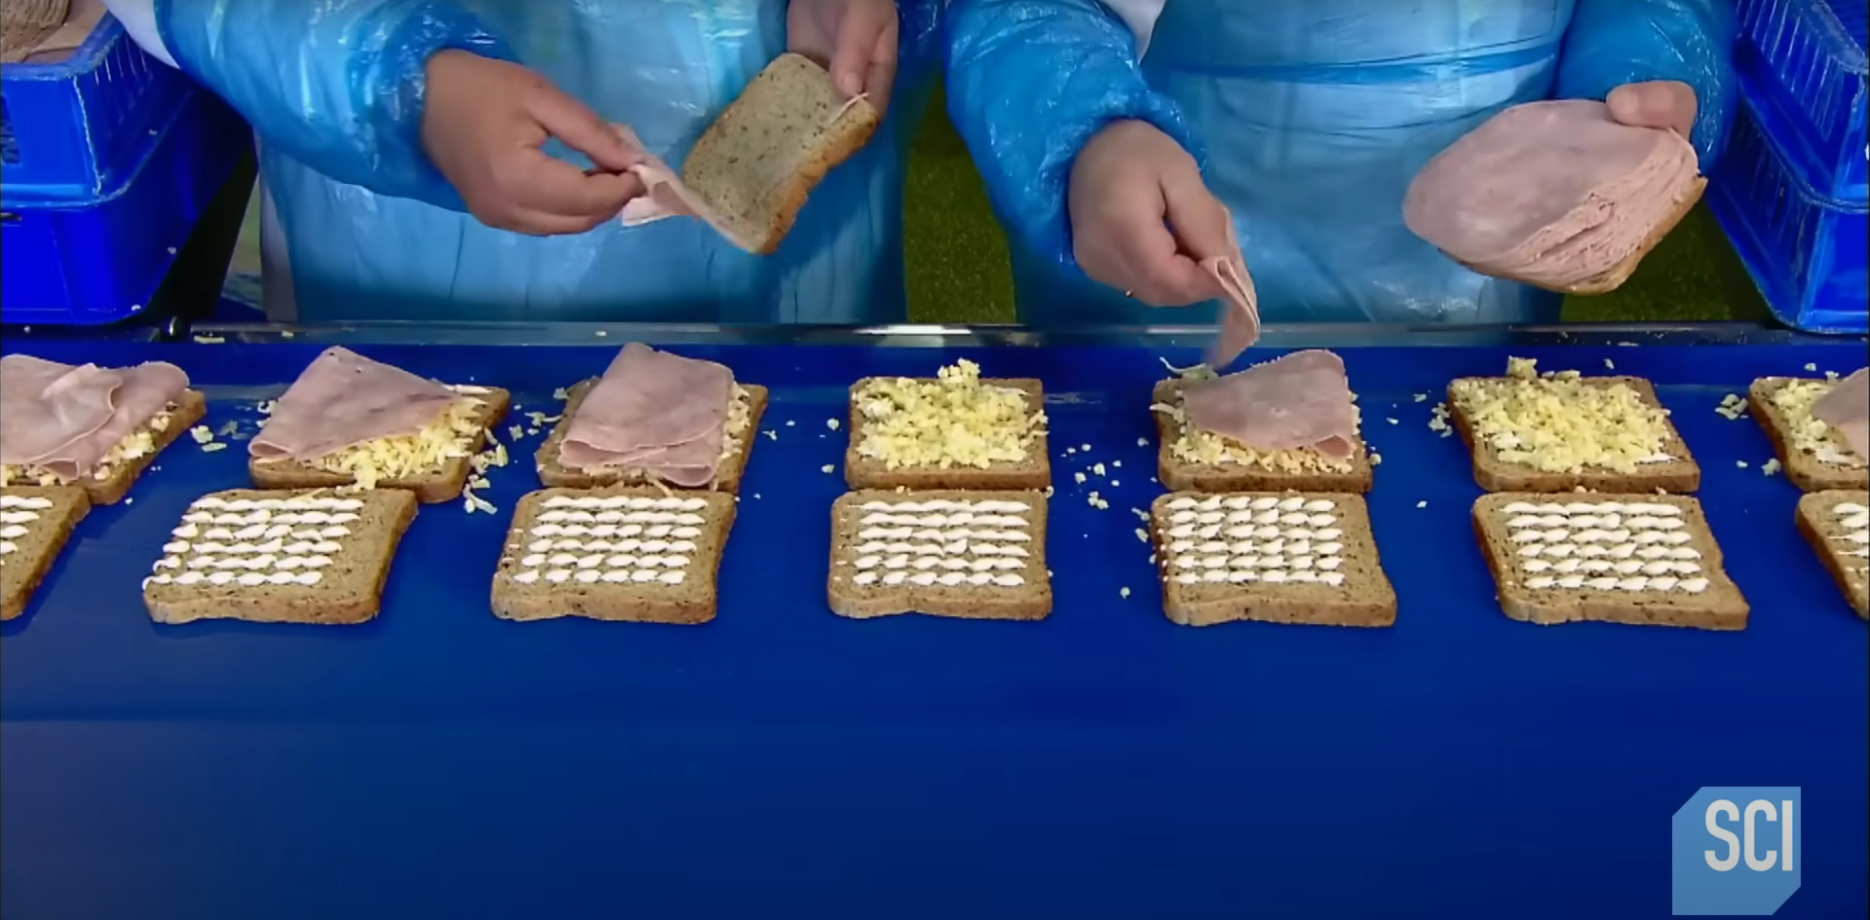
Step 6
Putting ham to sandwiches with hand.

Slide 8
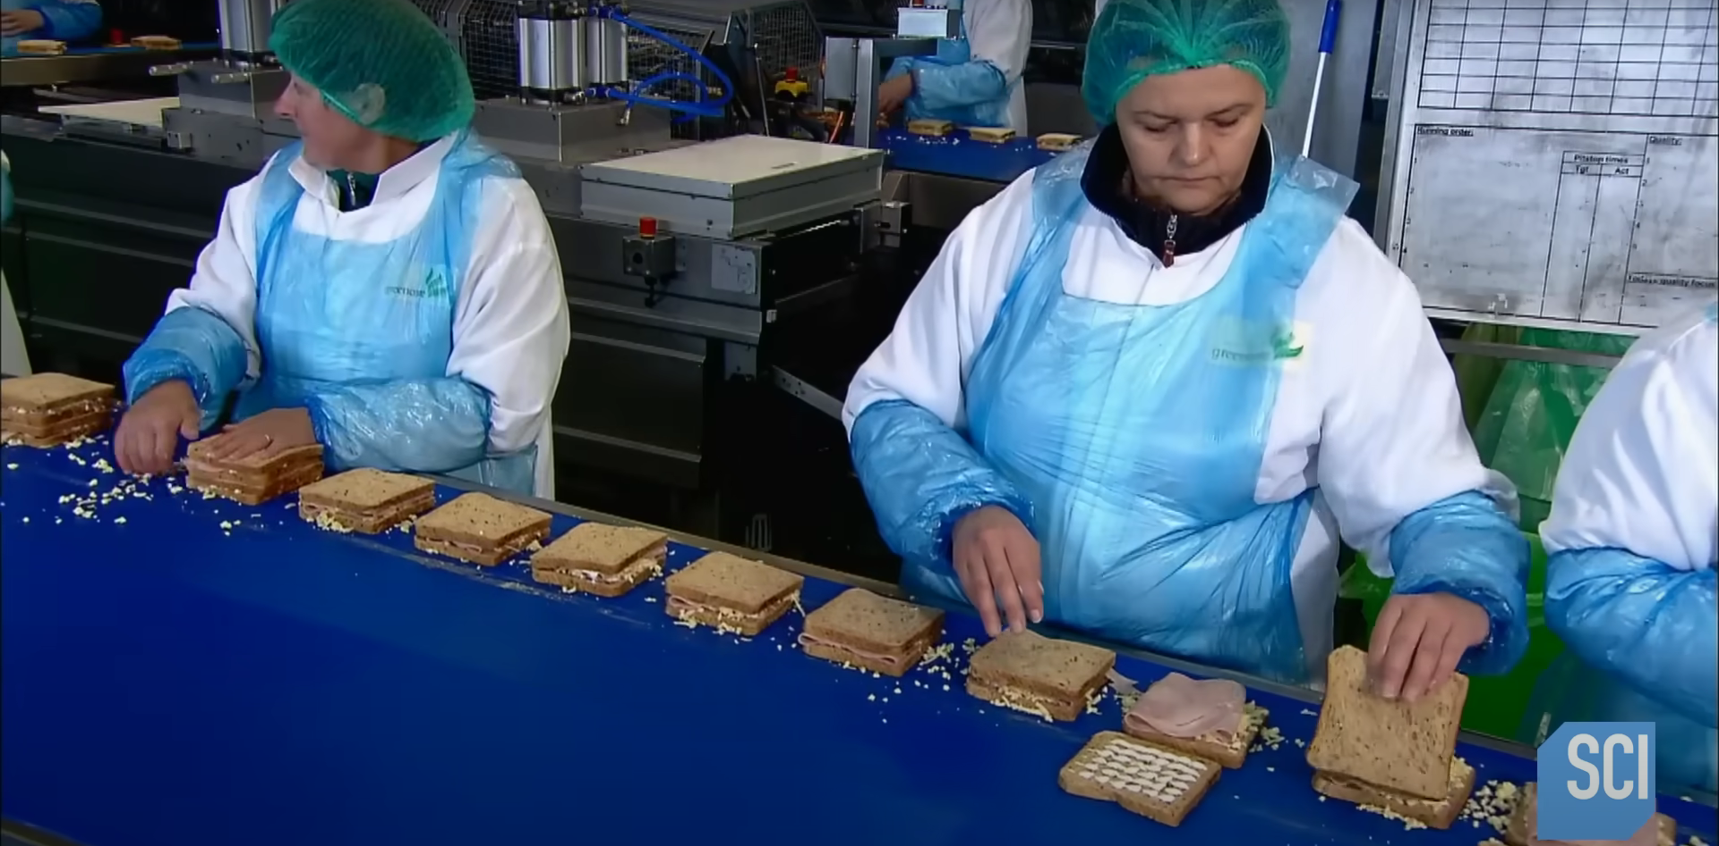
Step 7
Sandwich splits put together.

Slide 9
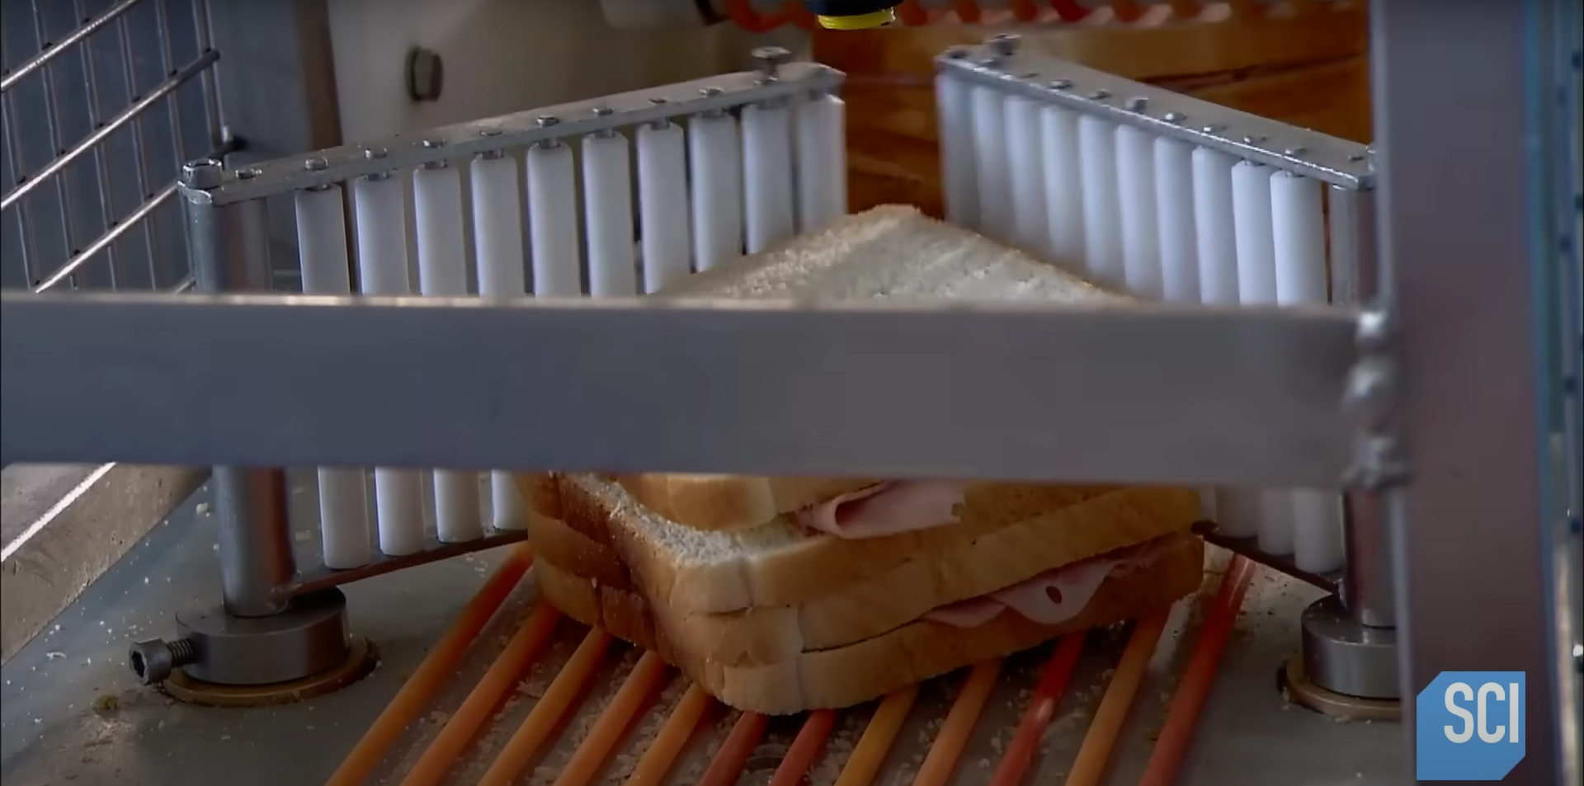
Step 8
Putting sandwiches to a mechanized cutter

Slide 10
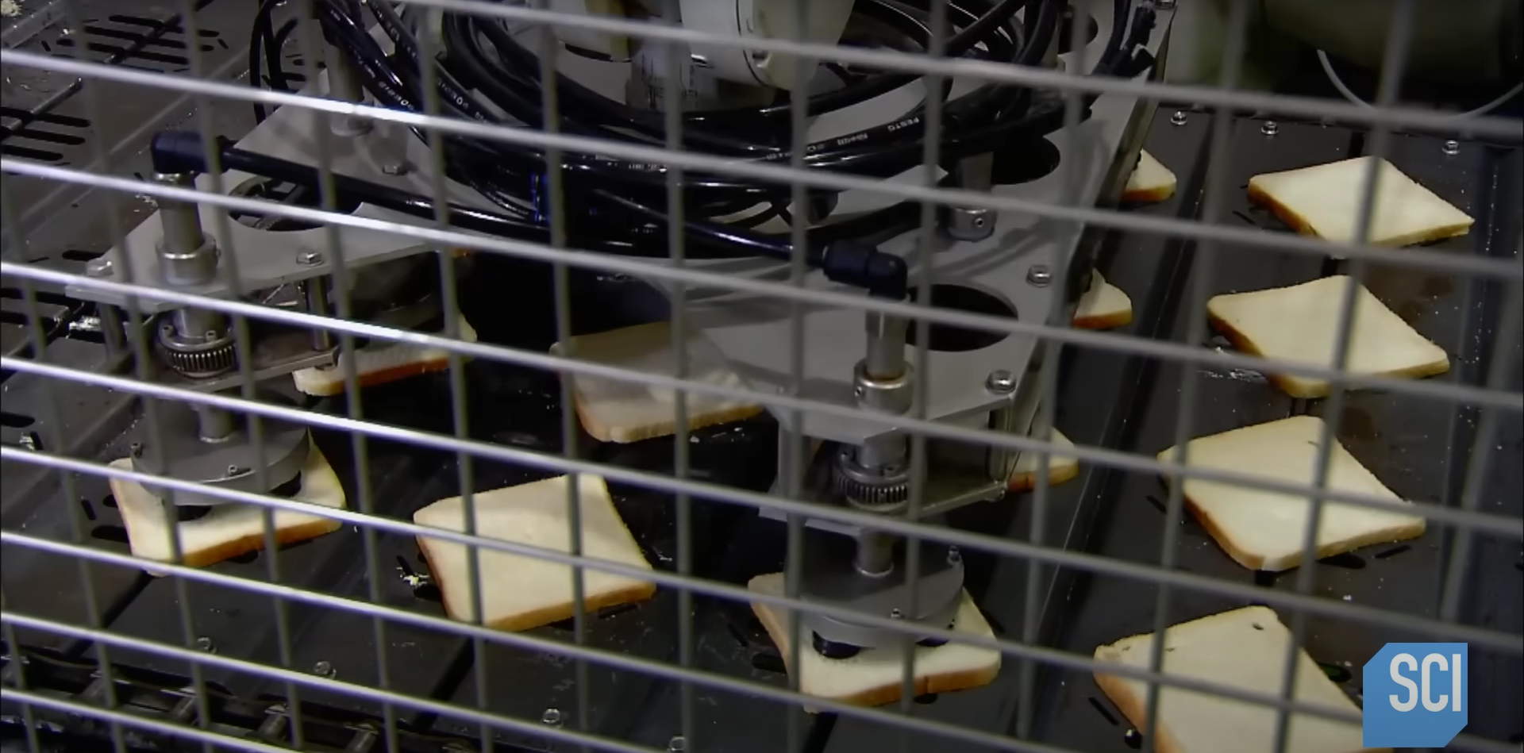
Step 9
Suction robot putts single bread slices (again?)

Slide 11
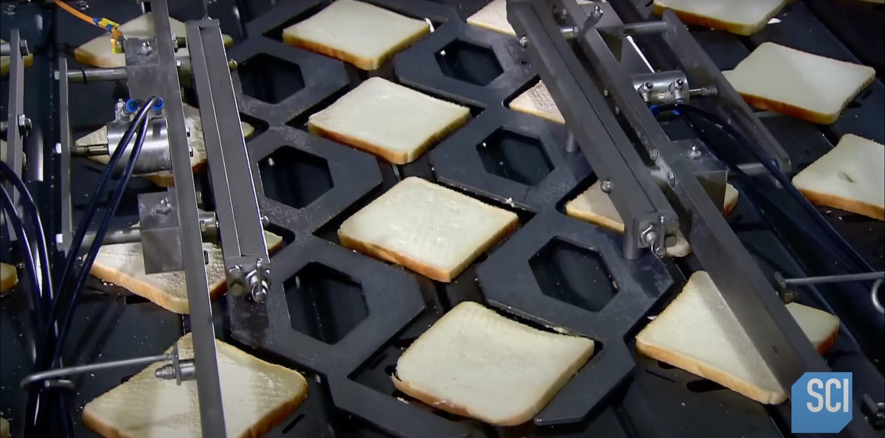
Step 10
Adjusting slices in position

Slide 12
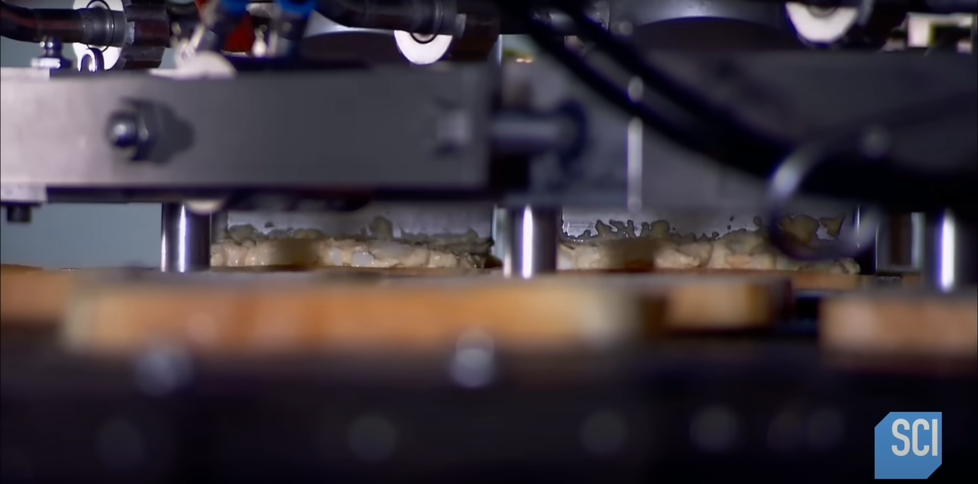
Step 11
Nozzle puts a sauce on sandwich pieces

Slide 13
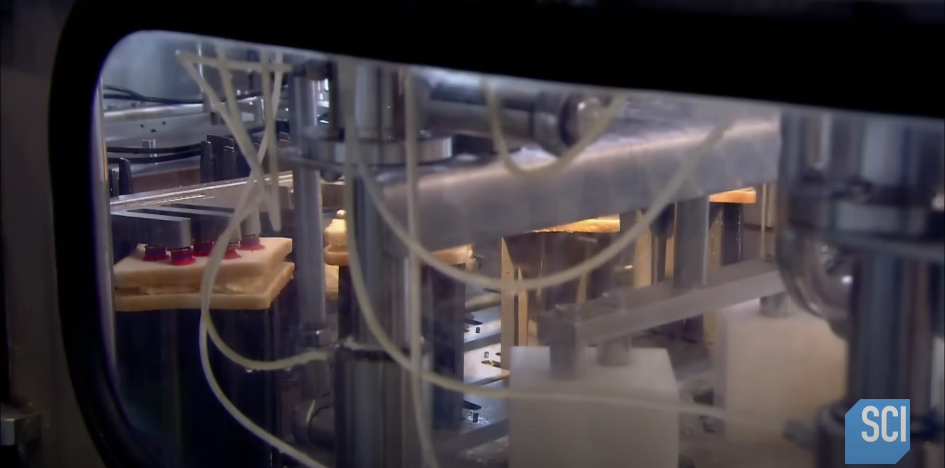
Step 12
Connecting two pieces together with suction cups

Slide 14
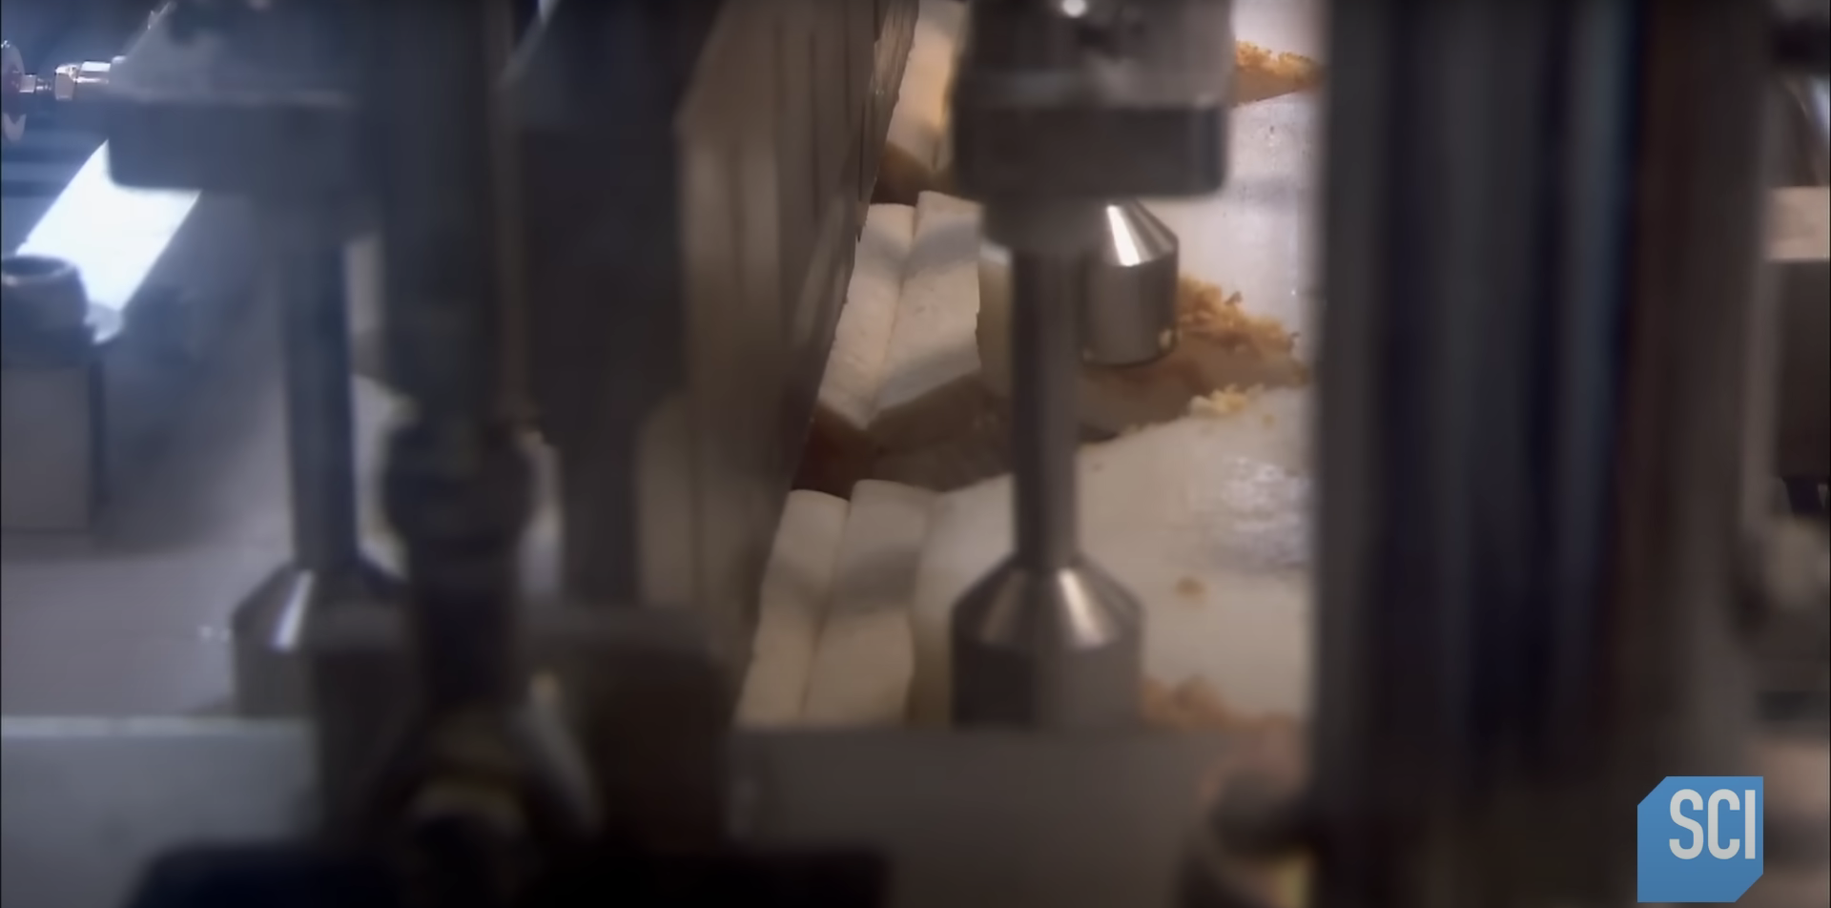
Step 13
Ultrasonic cutting for cleaner edge

Slide 15
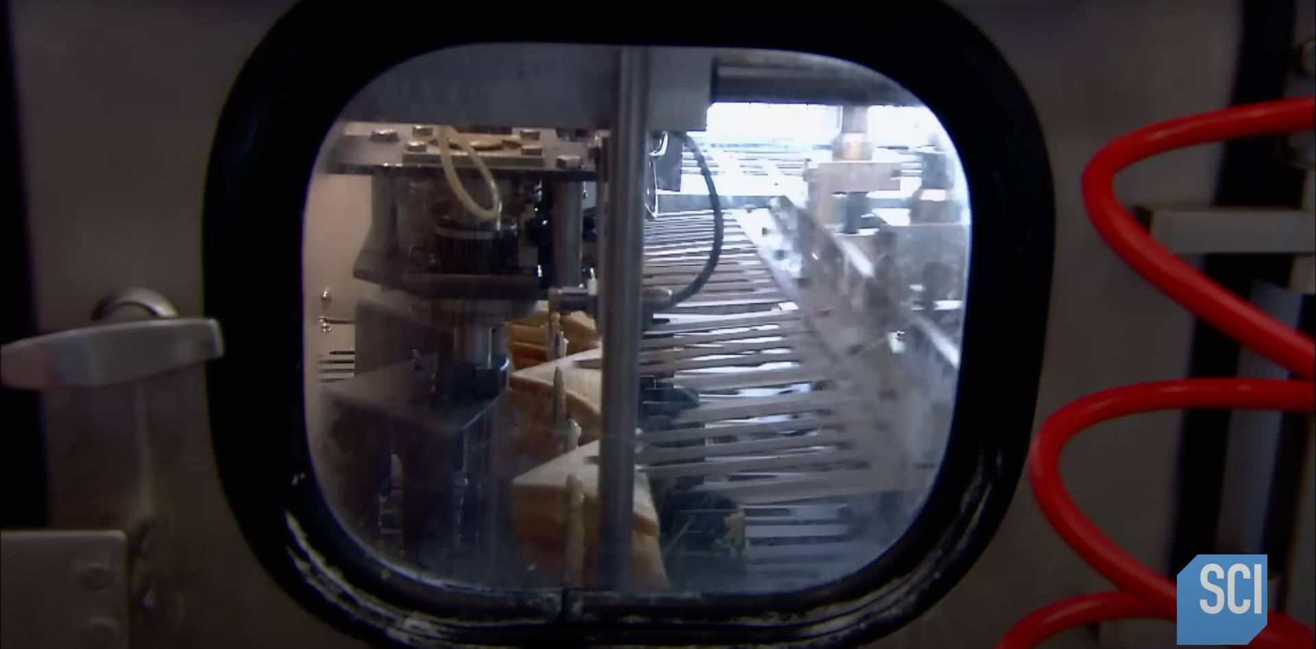
Step 13
Slices are being rotated and grabbed

Slide 16
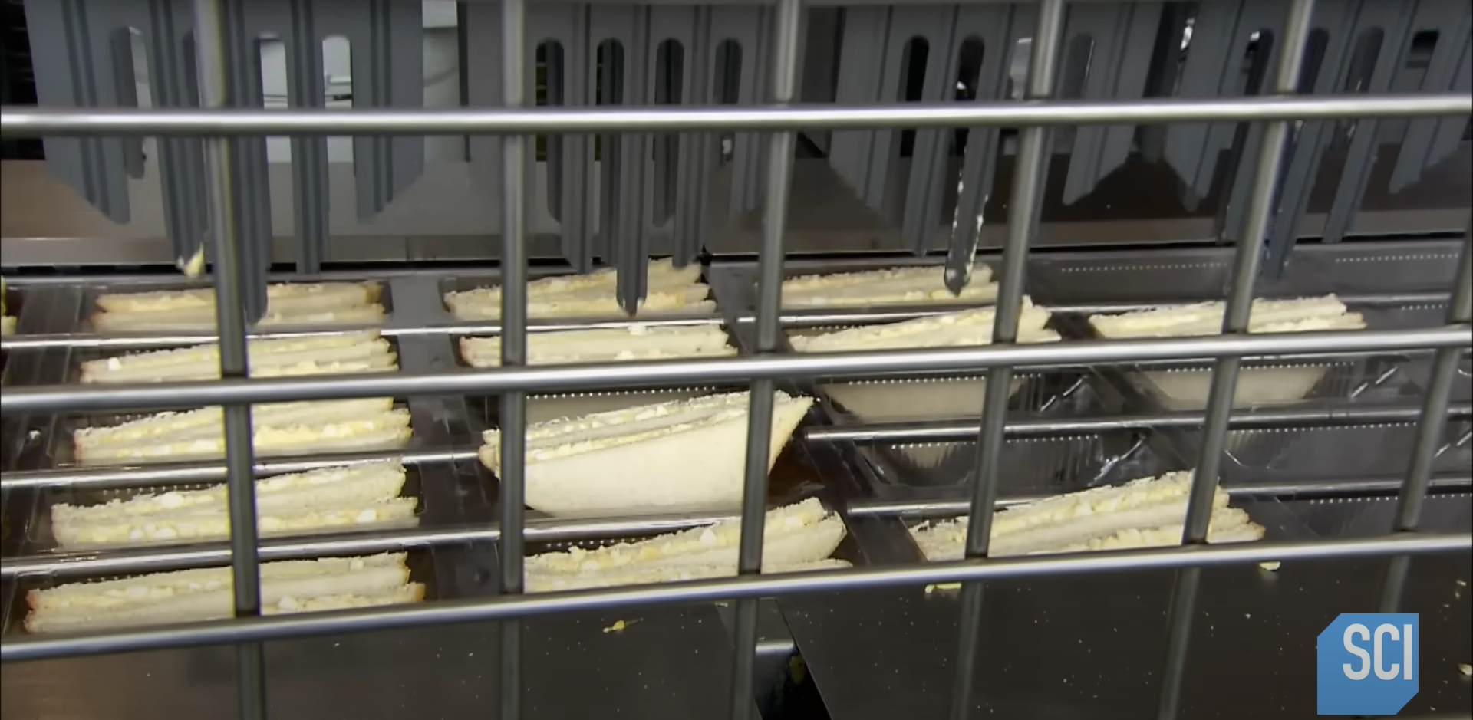
Step 14
Sandwiches packed into plastic trays

Slide 17
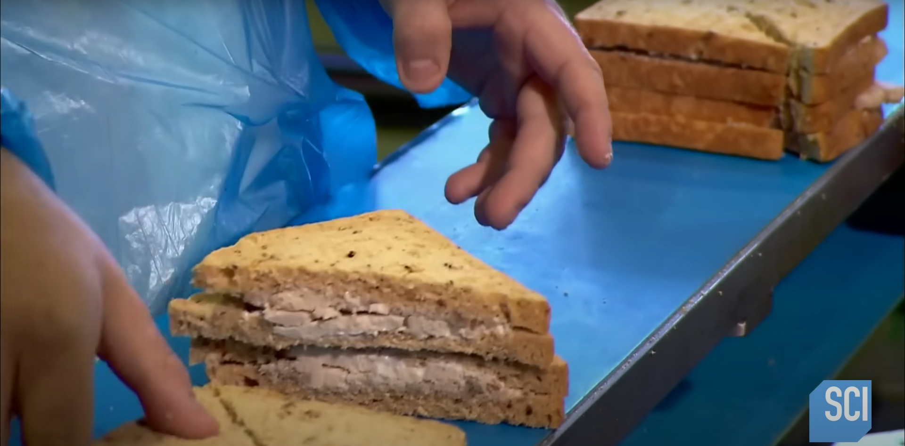
Step 15
Stacking sandwiches on one another

Slide 18
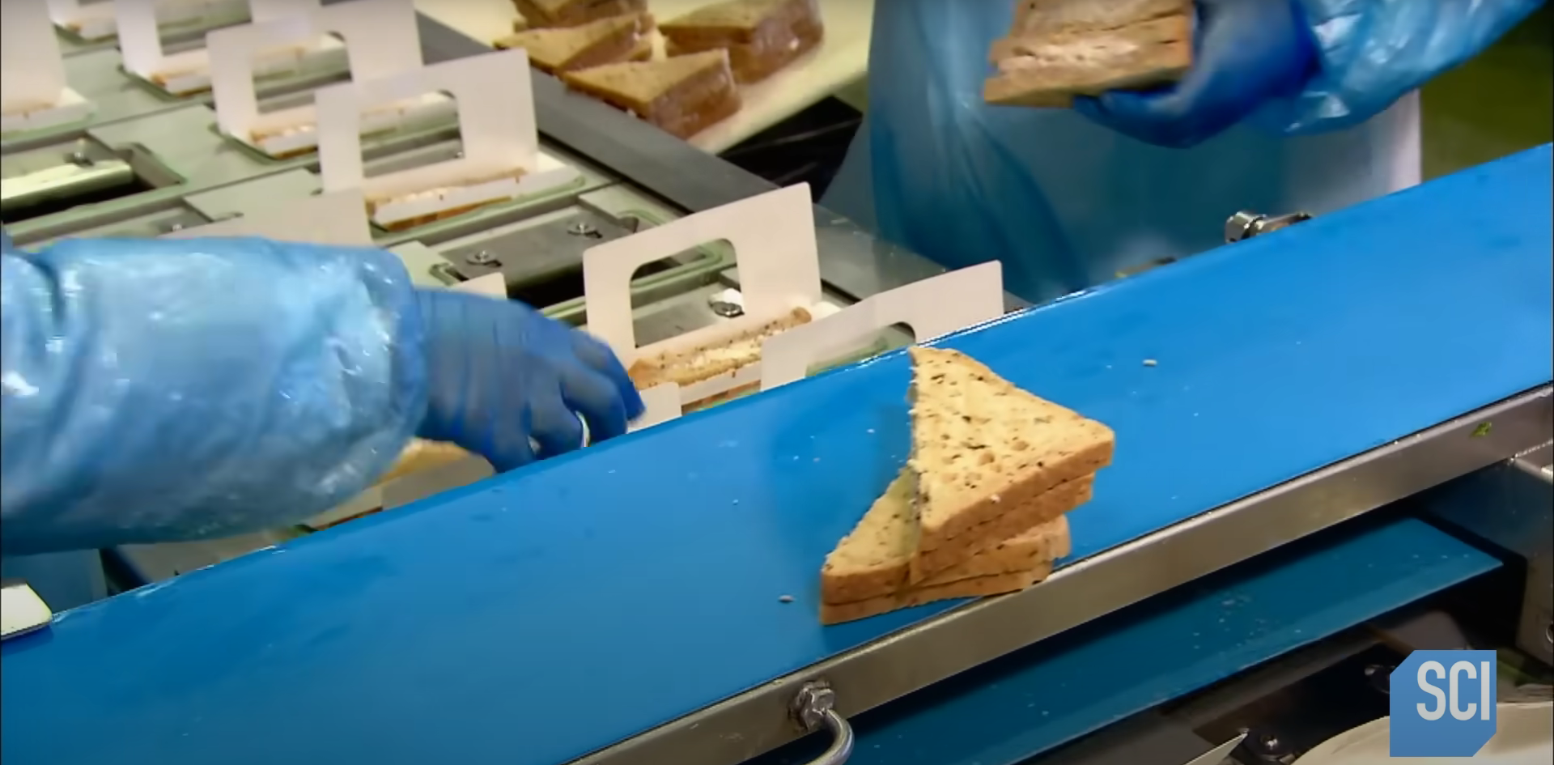
Step 16
Placing to cardboard packaging

Slide 19
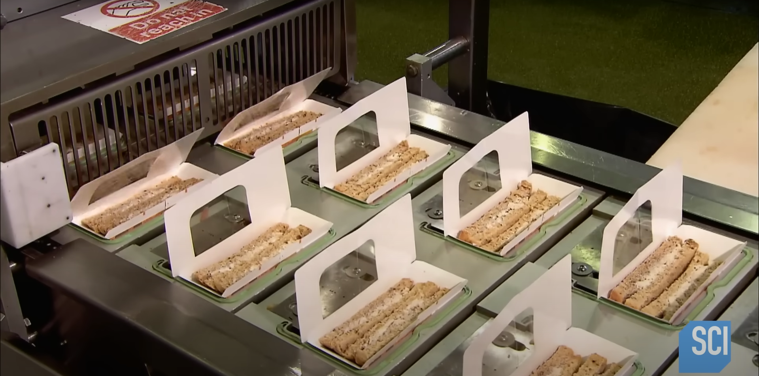
Step 17
Packing them all

